Slide 1
Analog and Digital Electronic Lab Subject Code:18csl37
To design and implement a rectangular waveform generator (op-amp relaxation oscillator) for a given frequency.

Slide 2
Relaxation Oscillator
Relaxation oscillator is a non-linear electronic oscillator circuit that generates a continuous non-sinusoidal output signal in the form of rectangular wave, triangular wave or a saw-tooth wave. The time period of non-sinusoidal output depends on the charging time of the capacitor connected in the oscillator circuit.
Relaxation oscillator is also called as Free running oscillator.

Slide 3
Relaxation Oscillator
In this figure the op-amp operates in the saturation region. Here, a fraction (R2/(R1+R2)) of output is fed back to the noninverting input terminal.
Thus reference voltage is (R2/(R1+R2)) Vo and may take values as +(R2/(R1+R2)) Vsat or - (R2/(R1+R2)) Vsat.
The output is also fed back to the inverting input terminal after integrating by means of a low-pass RC combination. Thus whenever the voltage at inverting input terminal just exceeds reference voltage, switching takes place resulting in a square wave output.

Slide 4
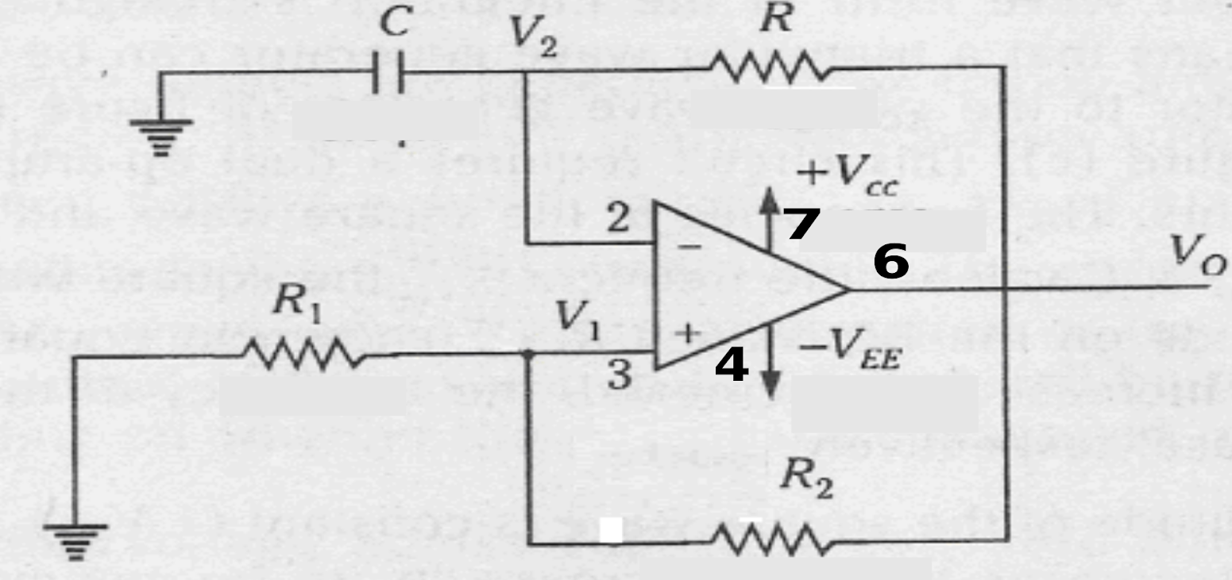
CIRCUIT DIAGRAM

Slide 5
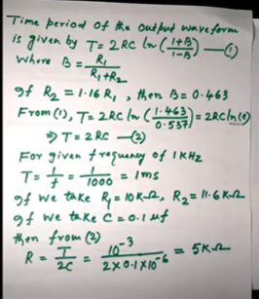
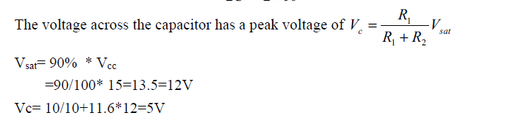
Relaxation Oscillator
Design:

Slide 6
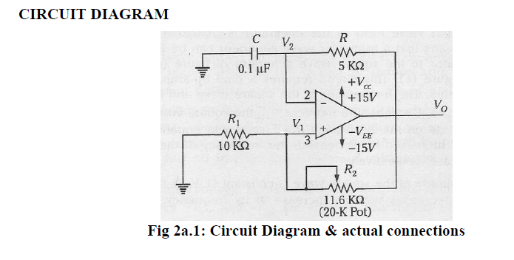
Relaxation Oscillator

Slide 7
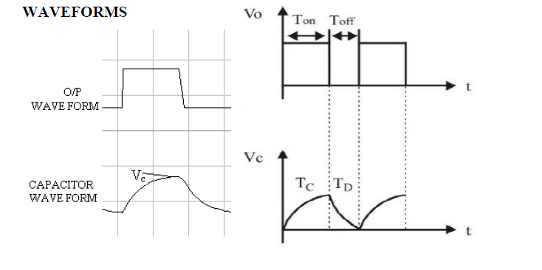
WAVEFORMS

Slide 8
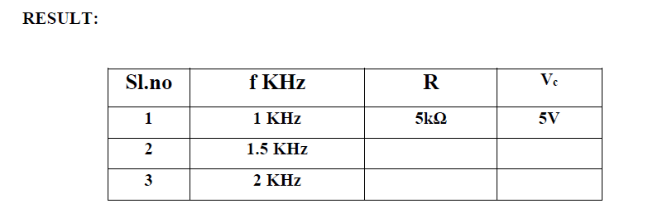
Relaxation Oscillator

Slide 9
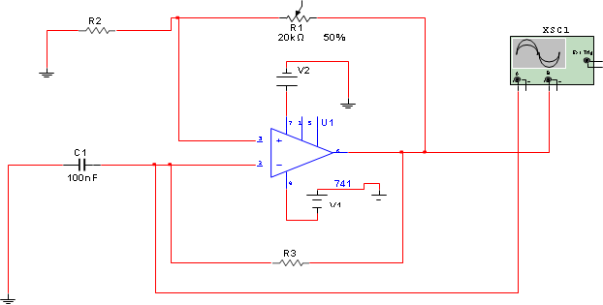
Relaxation Oscillator using Multisim

Slide 10
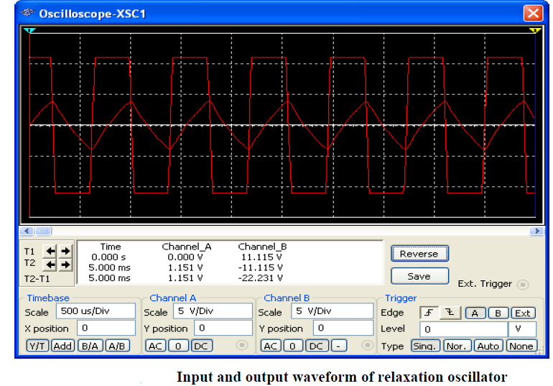
WAVEFORMS

Slide 11
Thank you

